Slide 1
caB2B – Visual Design Options
10th January, 2007

Slide 2
Visual Design Option 1

Slide 3
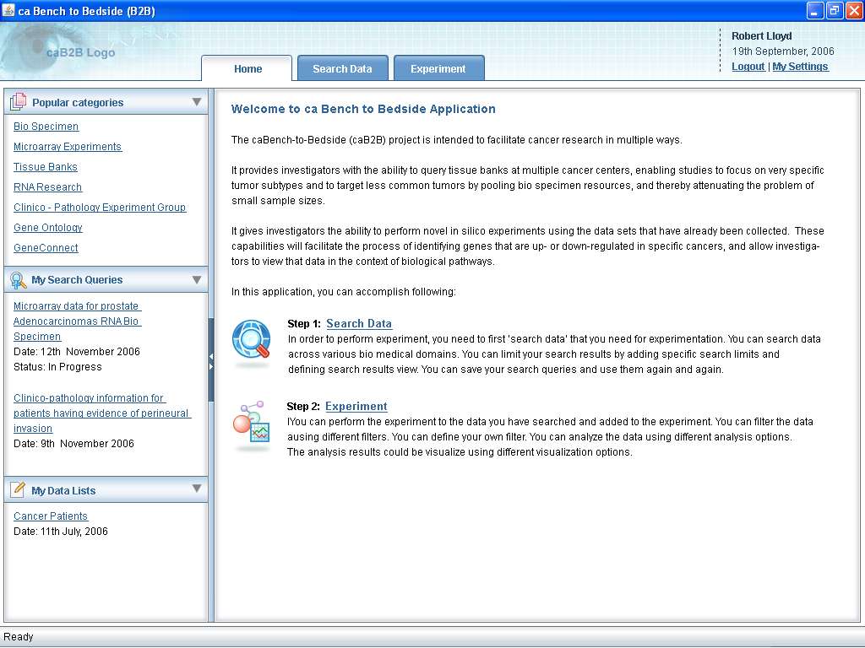

Slide 4
Visual Design Option 2

Slide 5
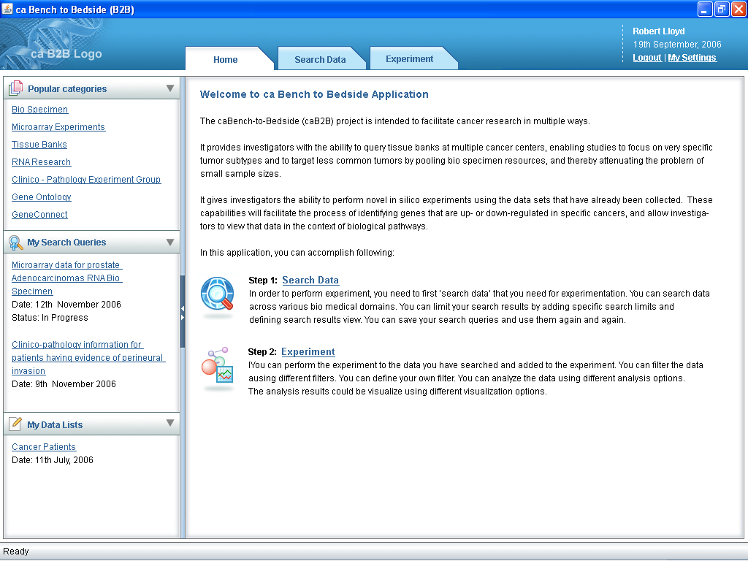

Slide 6
Thanks

